Slide 1
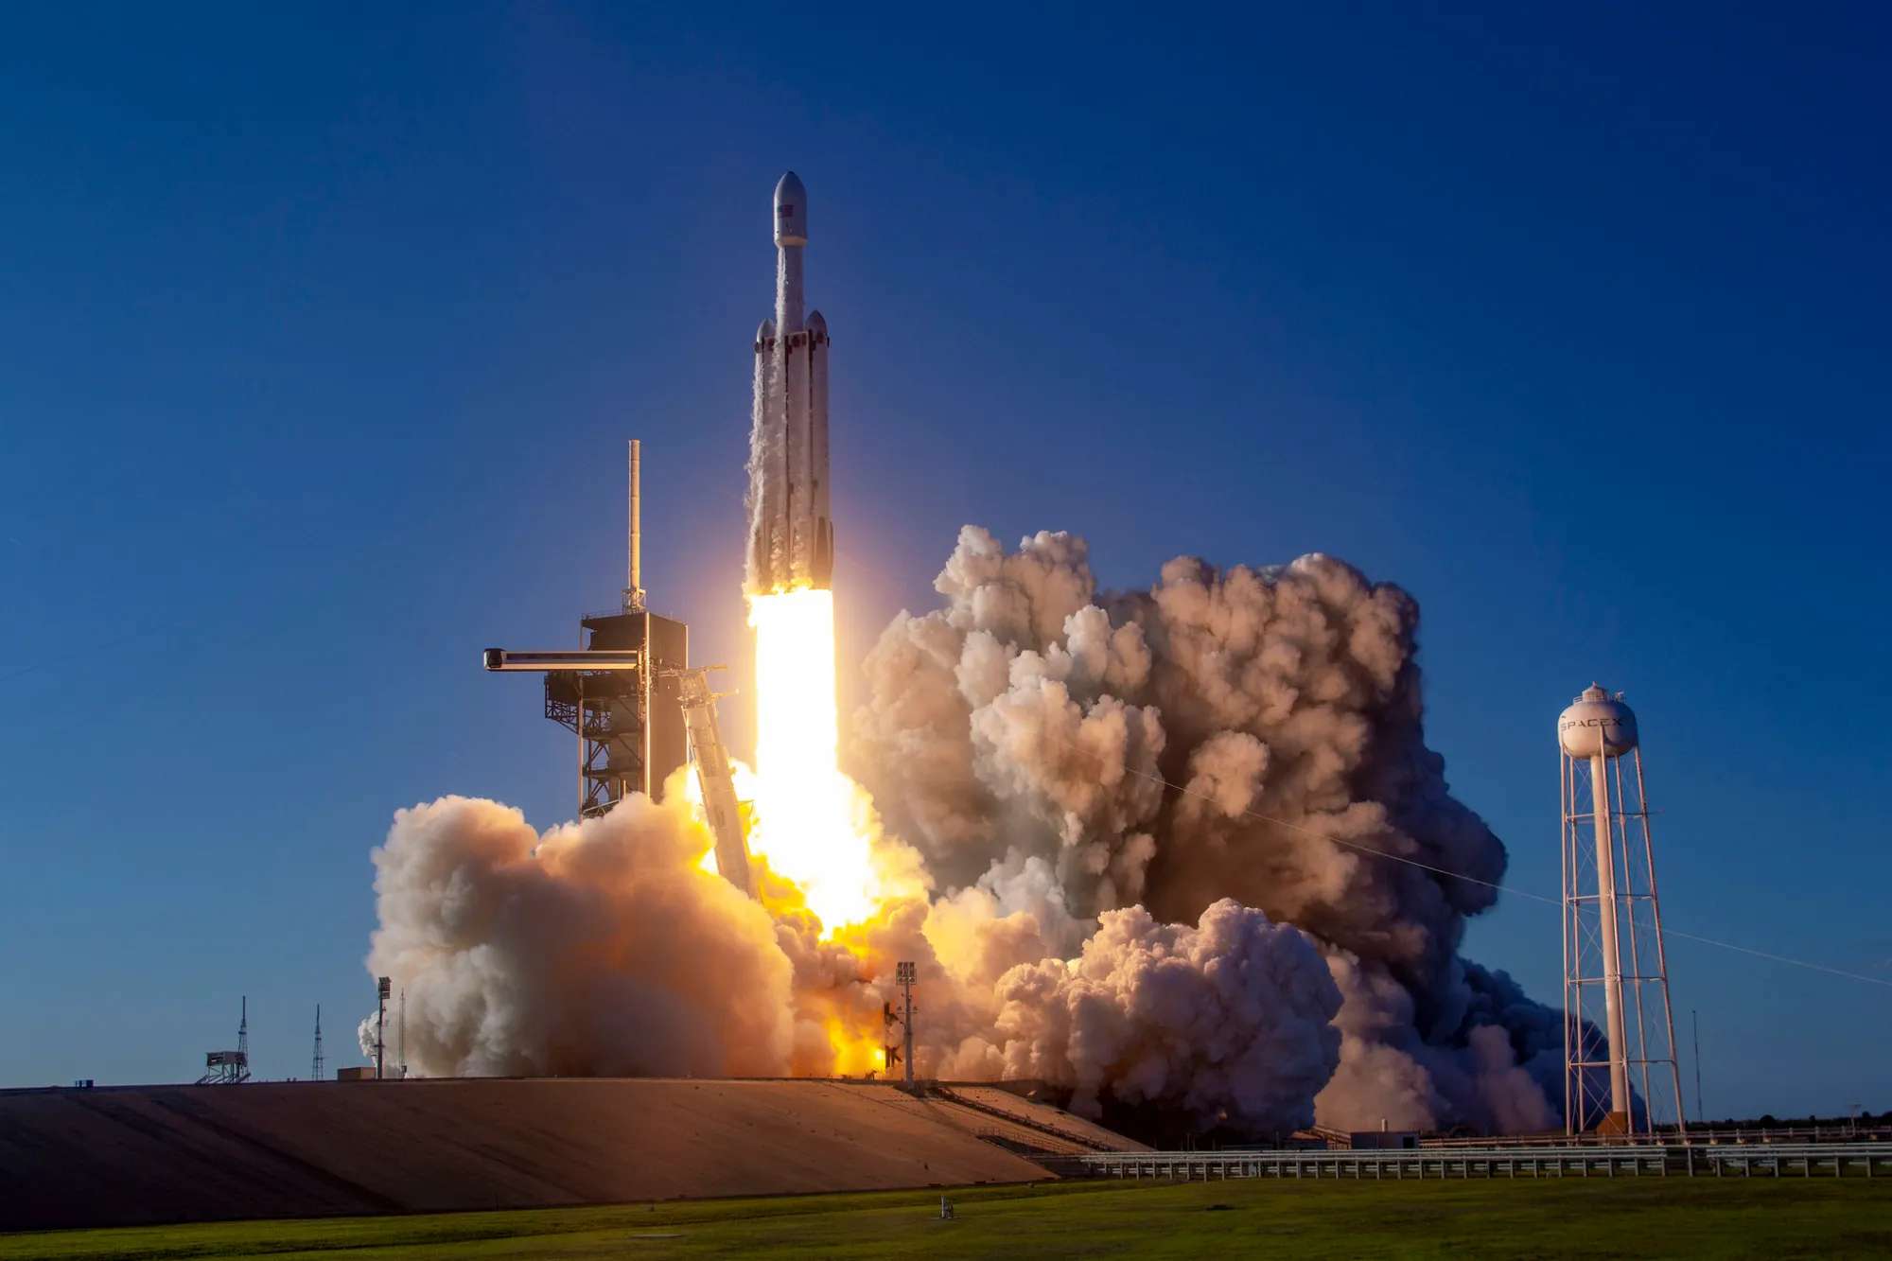
Applied Data Science Capstone
Tien Chi Lin
23.12.2024
Background Image: Media Invited to SpaceX Falcon Heavy Launch of Four NASA Missions

Slide 2

Outline
Executive Summary
Introduction
Methodology
Results
Conclusion
Appendix

Slide 3
Executive Summary
Summary of methodologies
Data collection
Data wrangling
Exploratory Data Analysis with Data Visualization
Exploratory Data Analysis with SQL
Interactive Visual Analytics with Folium
Interactive Dashboard with Plotly Dash
Machine Learning Based Predictive Analysis
Summary of all results
Exploratory Data Analysis
ddd
ddd

Slide 4
Introduction
Project background and context
SpaceX is an American aerospace manufacturer and space transportation services company with the goal of revolutionizing space technology and making space travel more affordable and accessible. In this capstone, we will predict if the Falcon 9 first stage will land successfully. SpaceX advertises Falcon 9 rocket launches on its website with a cost of 62 million dollars; other providers cost upward of 165 million dollars each, much of the savings is because SpaceX can reuse the first stage. Therefore, if we can determine if the first stage will land, we can determine the cost of a launch. This information can be used if an alternate company wants to bid against SpaceX for a rocket launch.
Questions to be answered
How do variables such as payload mass, orbit type, flight number, and launch site lead to the success of the first-stage landing?
What is the best machine learning algorithm to predict the success of the first-stage landing?

Slide 5

Section 1

Slide 6
Methodology
Data collection
Launch data using SpaceX Rest API
Launch records from Wikipedia using Web Scraping
Data wrangling
Filtering data, dealing with missing values
Labeling landing outcome as 0 (failure) / 1(success)
Exploratory data analysis (EDA) using visualization and SQL
Interactive visual analytics using Folium and Plotly Dash
Predictive analysis using classification models
Feature engineering with OneHotEncoder
Grid search for hyperparameter tuning
Algorithms with Logistic regression, Support vector machine (SVM), Decision tree, and K-nearest neighbor (KNN)

Slide 7
Data Collection
In this stage, we collected launch data via SpaceX REST API calls and launch records via Web scraping of the SpaceX Wikipedia. Both collected data are crucial for complete launch information and further comprehensive analysis.
Launch data via SpaceX REST API
FlightNumber, Date, BoosterVersion, PayloadMass, Orbit, LaunchSite, Outcome, Flights, GridFins, Reused, Legs, LandingPad, Block, ReusedCount, Serial, Longitude, Latitude
Launch Records via Wikipedia Web scraping
Flight No., Launch site, Payload, PayloadMass, Orbit, Customer, Launch outcome, Version Booster, Booster landing, Date, Time

Slide 8
Data Collection – SpaceX API
Request raw launch data via SpaceX API call
Decode response content and turn it into Pandas dataframe
Request detail launch information via API calls
Construct obtained data into new Pandas dataframe
Filter dataframe to only include Falcon 9 launches
Replace missing values in PayloadMass with its mean
Export dataframe to CSV
GitHub URL: Data Collection API

Slide 9
Data Collection - Scraping
Request Falcon 9 launch records from Wikipedia
Create BeautifulSoup object to parse HTML response
Extract all column/variable names from HTML table header
Create dataframe by parsing HTML tables
Export dataframe to CSV
GitHub URL: Data Web Scraping

Slide 10
Data Wrangling
Calculate the number of launches on each site
Calculate the number and occurrence of each orbit
Calculate the number and occurence of mission outcome of the orbits
Create a landing outcome label from Outcome column
Export dataframe to CSV
The data contains several Space X launch facilities. Therefore, we first determine the number of launches based on the column LaunchSite.
The data contains multiple orbit types for launch tasks. Therefore, we also calculate the number and occurrence of each orbit.
The data contains detailed outcomes in the column Outcome, such as True Ocean/ False Ocean representing successful/ unsuccessful landing to a specific region of the ocean. Therefore, we determine the number of outcomes based on different outcome type.
We convert those outcome labels into classification variables 1 and 0, indicating successful and unsuccessful landing, respectively.
GitHub URL: Data Wrangling

Slide 11
EDA with Data Visualization
Scatter plot: Display relationship between variables
Line plot: Display the data trend over time
Flight Number
vs.
Payload Mass
Flight Number
vs.
Launch Site
Payload Mass
vs.
Launch Site
Flight Number
vs.
Orbit Type
Payload Mass
vs.
Orbit Type
Orbit Type
vs.
Success Rate
Year
vs.
Success Rate
Bar plot: Display categorical data for comparison among groups
GitHub URL: EDA with Data Visualization

Slide 12
EDA with SQL
Performed SQL queries:
Display the names of the unique launch sites in the space mission
Display 5 records where launch sites begin with the string 'CCA’
Display the total payload mass carried by boosters launched by NASA (CRS)
Display average payload mass carried by booster version F9 v1.1
List the date when the first successful landing outcome in ground pad was achieved
List the names of the boosters which have success in drone ship and have payload mass greater than 4000 but less than 6000
List the total number of successful and failure mission outcomes
List the names of the booster versions which have carried the maximum payload mass. Use a subquery
List the records which will display the month names, failure landing outcomes in drone ship, booster versions, launch site for the months in year 2015
Rank the count of landing outcomes (such as Failure (drone ship) or Success (ground pad)) between the date 2010-06-04 and 2017-03-20, in descending order
GitHub URL: EDA with SQL

Slide 13
Build an Interactive Map with Folium
Markers of all Launch Sites
Obtain intuitive visual insights
Colored Markers of Launch outcomes for each Launch Site
Identify the difference in success rate between launch sites
Distances between Launch Site to its proximities
Identify the proximities of the launch site CCAFS SLC-40 (as an example), such as coastline, railway, highway, and city
Obtain further insights from colored lines displaying distances between the launch site and its proximities
GitHub URL: Interactive Visual Analytics with Folium

Slide 14
Build a Dashboard with Plotly Dash
Launch Site Dropdown List
Select either all sites or a single site for analysis display
Pie Chart of Success Launches
Display each site’s proportion of the total successful launches
Display the proportion of successful and failed launches for a single site
Slider of Payload Mass Range
Select the payload range to display in the scatter chart
Scatter Chart of Payload Mass vs. Success Launches
Display the correlation between payload and launch success
Display the launch success color-labeled by Booster version
GitHub URL: SpaceX Dash App

Slide 15
Predictive Analysis (Classification)
Prepare input variables (Feature Engineering) and output variable (‘Class’ in launch data)
Standardize input variables
Split input/output variables into training and testing sets
Create GridSearchCV object for hyperparameter tuning
Apply GridSearchCV on four machine learning models Logistic regression, Support vector machine (SVM), Decision tree, and K-nearest neighbor (KNN)
Calculate accuracy on the test data
Examine confusion matrix
Determine the method with best performance on the overall data
GitHub URL: Machine Learning Prediction

Slide 16
Results
Exploratory data analysis results
Interactive analytics demo in screenshots
Predictive analysis results

Slide 17

Section 2

Slide 18
EDA with Visualization

Slide 19
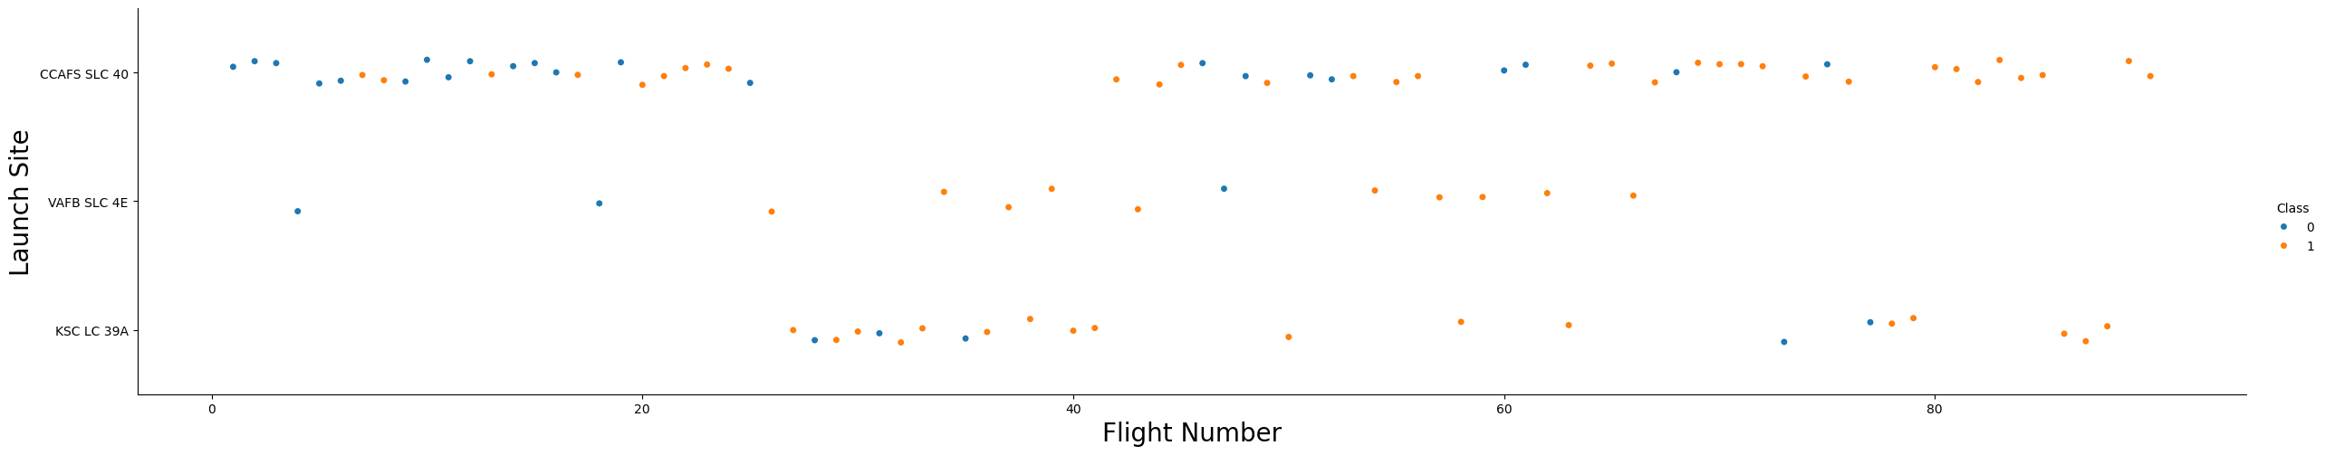
Flight Number vs. Launch Site
Explanation
The earliest flights tended to fail, while the latest ones tended to succeed, indicating an increase in success rate over time.
Most of the failures occurred at the CCAFS SLC 40 launch site, resulting in a lower success rate than the other two launch sites.

Slide 20
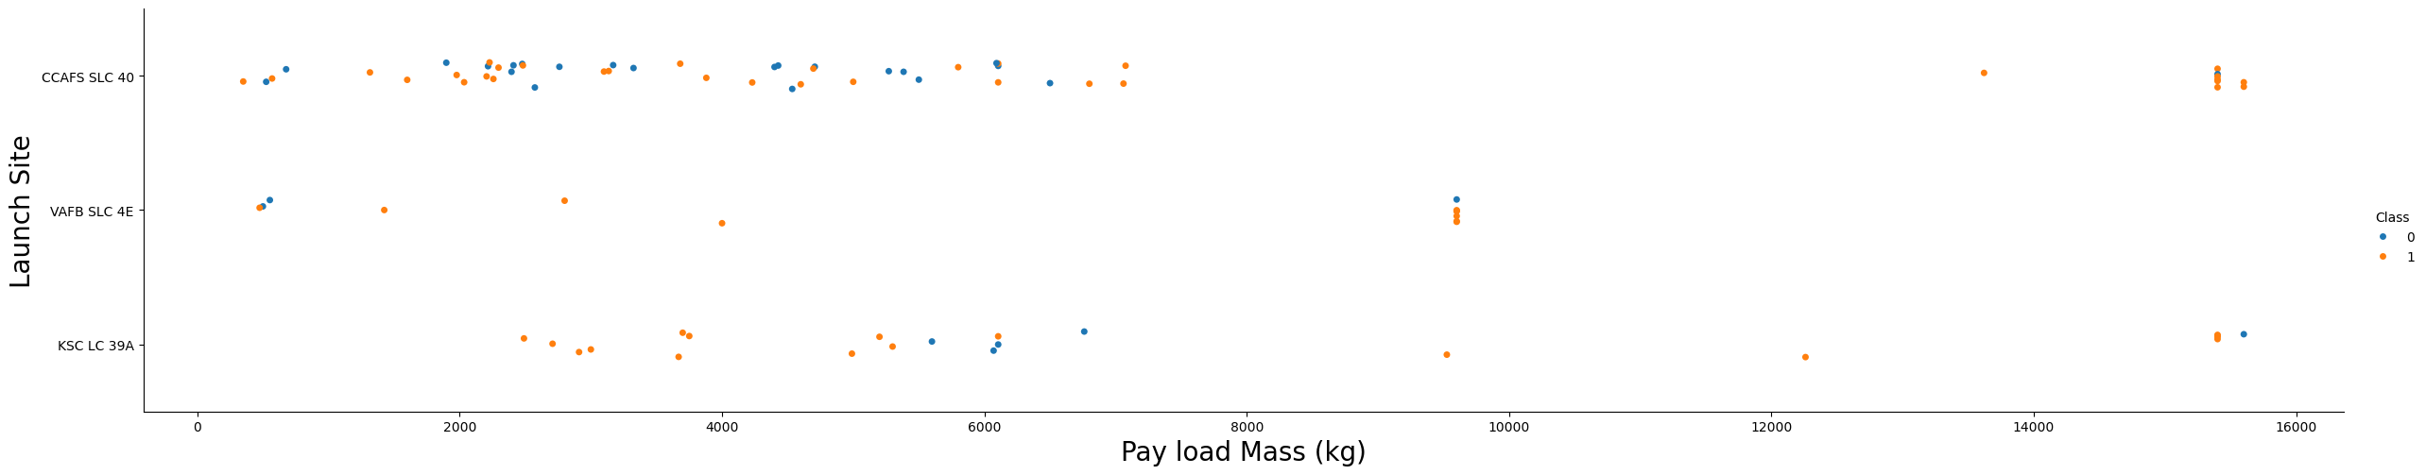
Payload vs. Launch Site
Explanation
Most launches with payload mass over 8000 kg were successful.
For the VAFB-SLC launch site there are no rockets launched for heavy payload mass (greater than 10000).

Slide 21
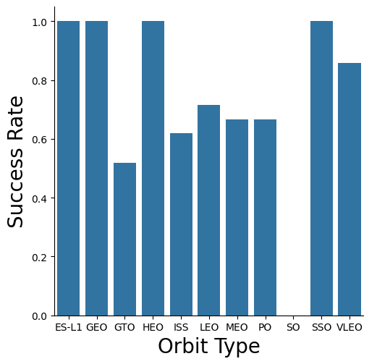
Success Rate vs. Orbit Type
Explanation
Orbits ES-L1, GEO, HEO, SSO have the highest success rate, 100%.
Orbit SO has the lowest success rate, 0%.
The success rate is above 60% for most orbit types, except orbit GEO which is 50% and SO which is 0%.

Slide 22
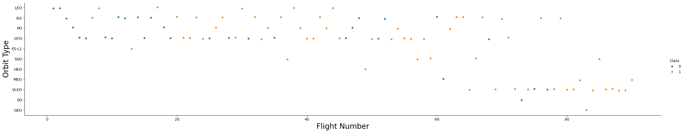
Flight Number vs. Orbit Type
Explanation
In the LEO orbit, success seems to be related to the number of flights.
Conversely, in the GTO orbit, there appears to be no relationship between flight number and success.

Slide 23
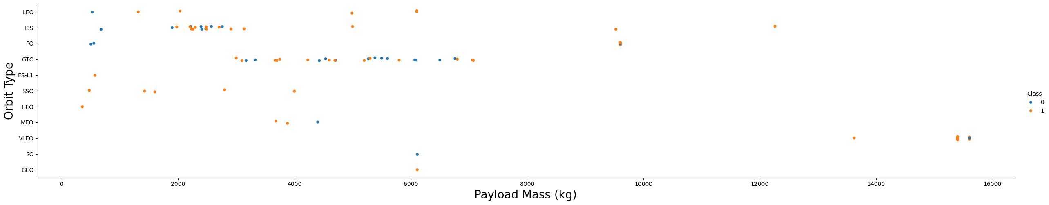
Payload vs. Orbit Type
Explanation
For LEO and ISS, there is positive relationship between payload mass and launch success.
For GTO, it's difficult to distinguish between successful and unsuccessful landings as both outcomes are present.
For SSO, there is more than one success, no failures, and only in the low payload range.

Slide 24
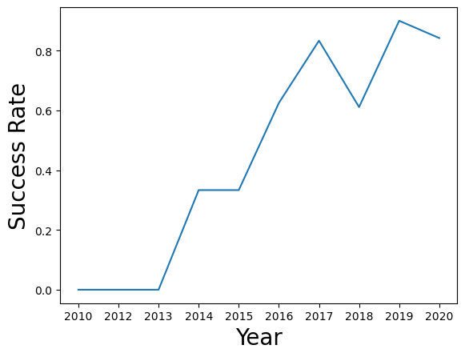
Launch Success Yearly Trend
Explanation
The success rate since 2013 kept increasing till 2020

Slide 25
EDA with SQL

Slide 26
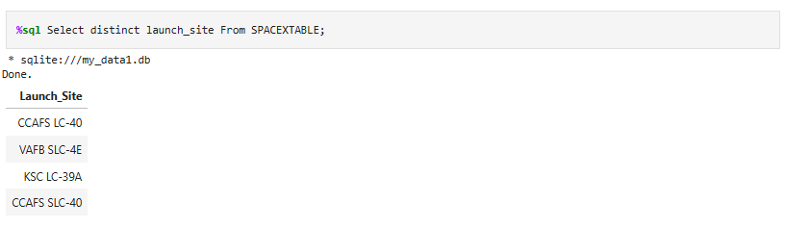
All Launch Site Names
Explanation
Display the names of the unique launch sites in the space mission

Slide 27
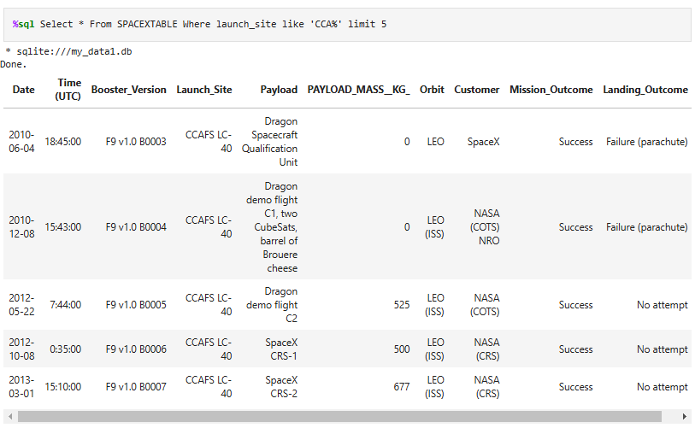
Launch Site Names Begin with 'CCA'
Explanation
Display 5 records where launch sites begin with the string 'CCA'

Slide 28
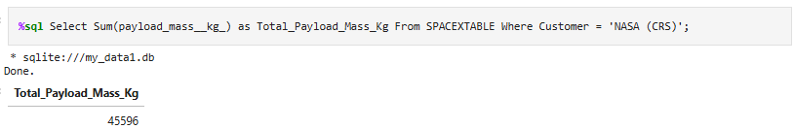
Total Payload Mass
Explanation
Display the total payload mass carried by boosters launched by NASA (CRS)

Slide 29
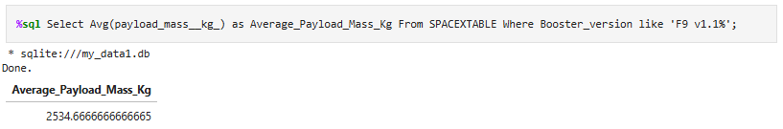
Average Payload Mass by F9 v1.1
Explanation
Display average payload mass carried by booster version F9 v1.1.

Slide 30
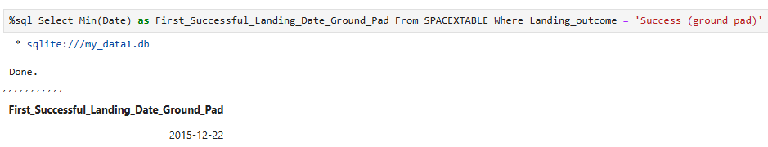
First Successful Ground Landing Date
Explanation
Display the date when the first successful landing outcome in ground pad was achieved.

Slide 31
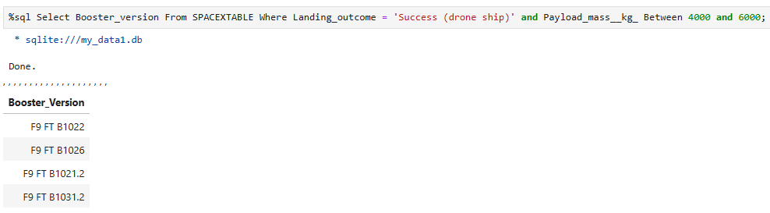
Successful Drone Ship Landing with Payload between 4000 and 6000
Explanation
List the names of the boosters which have success in drone ship and have payload mass greater than 4000 but less than 6000.

Slide 32
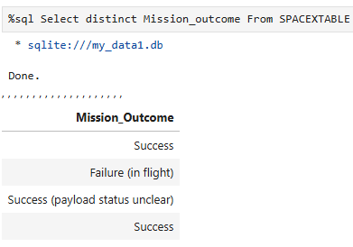
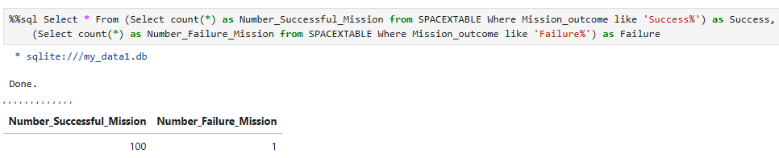
Total Number of Successful and Failure Mission Outcomes
Explanation
There are two ‘Success’ when displaying the distinct names of mission outcomes
List the total number of successful (regardless of details) and failure mission outcomes

Slide 33
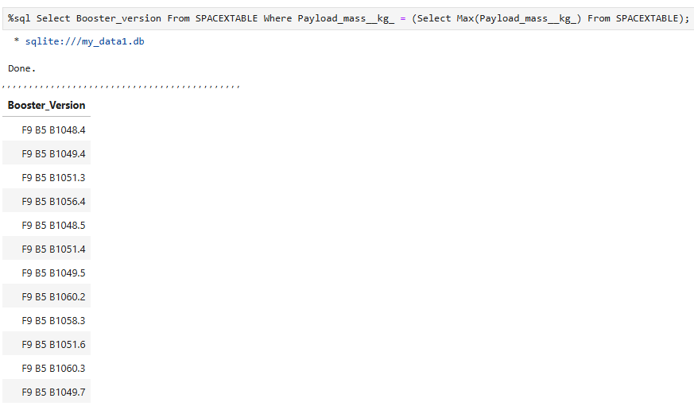
Boosters Carried Maximum Payload
Explanation
List the names of the booster versions which have carried the maximum payload mass.

Slide 34
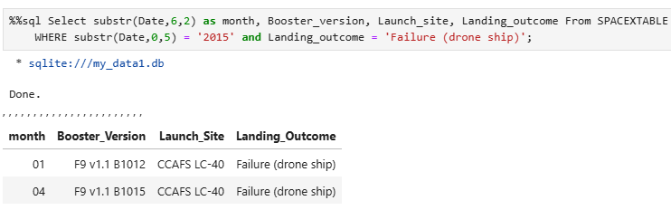
2015 Launch Records
Explanation
List the failed landing outcomes in drone ship, their booster versions and launch site names for the months in year 2015.

Slide 35
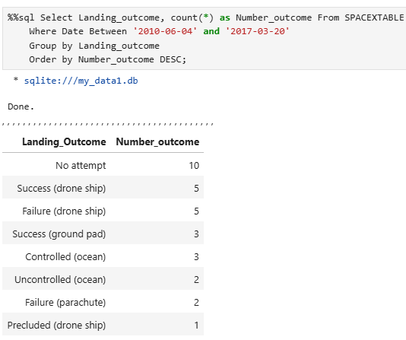
Rank Landing Outcomes Between 2010-06-04 and 2017-03-20
Explanation
Rank the count of landing outcomes (such as Failure (drone ship) or Success (ground pad)) between the date 2010-06-04 and 2017-03-20 in descending order.

Slide 36

Section 3

Slide 37
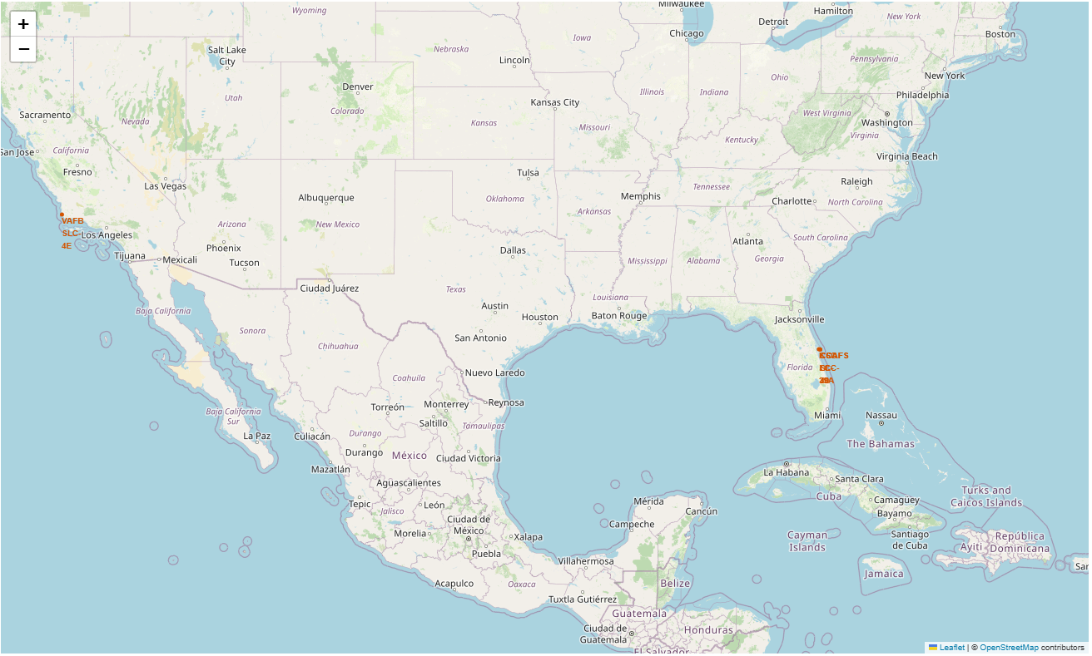
All launch sites’ location markers on a global map
Explanation
All launch sites are located as close to the equator as possible within the United States, since they can take advantage of the Earth's substantial rotational speed.
All launch sites are also in very close proximity to the coast, since we can ensure that no components are shed over populated areas.

Slide 38
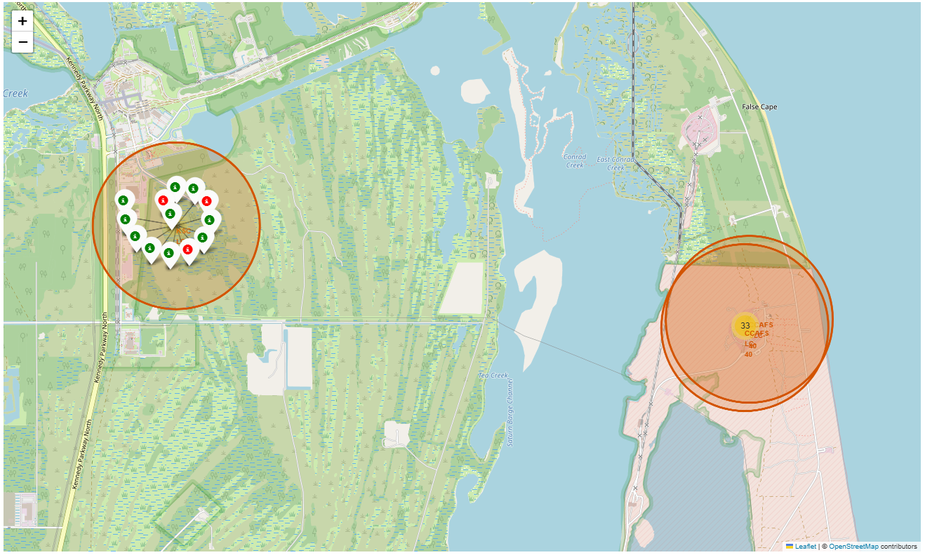
Color-labeled launch records on the map
Explanation
From the color-labeled markers we should be able to easily identify which launch sites have relatively high success rates.
Green Marker = Launch Success
Red Marker = Launch Failure
Launch Site KSC LC-39A has a very high Success Rate.

Slide 39
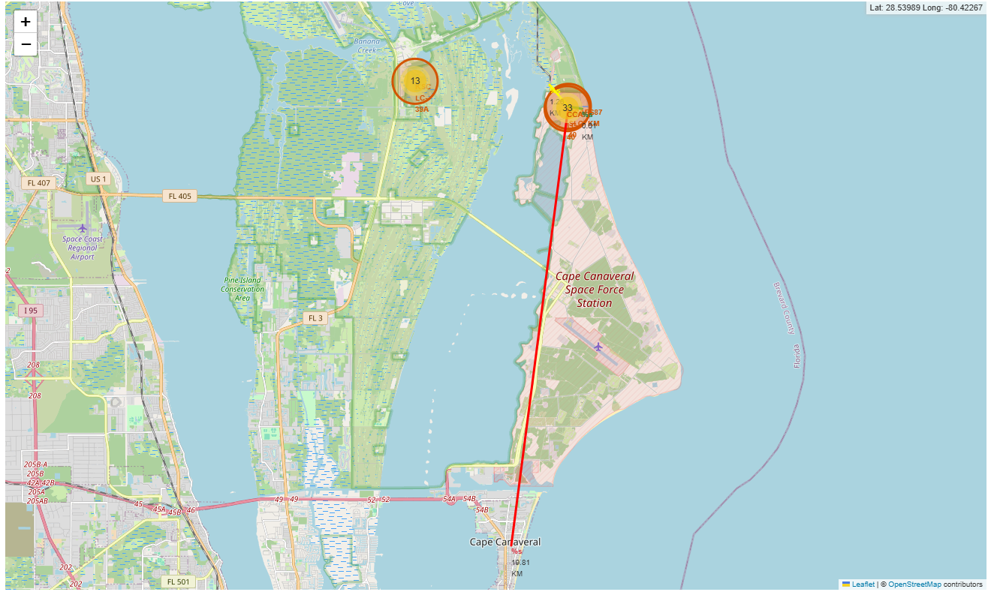
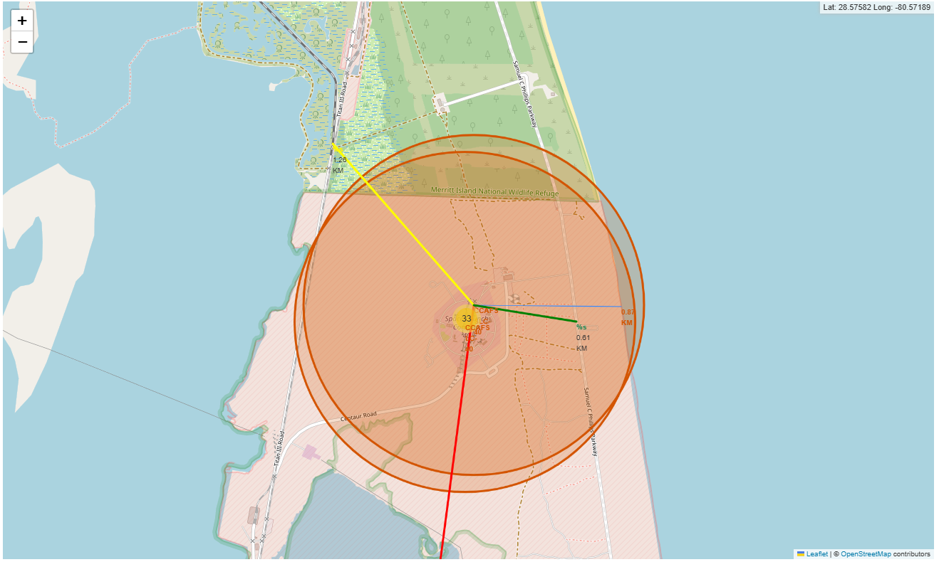
Distance from the launch site CCAFS SLC-40 to its proximities
Explanation
For the launch site CCAFS SLC-40, we can observe that:
Relatively close to railway (yellow line, 1.26 km)
Relatively close to highway (green line, 0.61 km)
Relatively close to coastline (blue line, 0.87 km)
The distance to the closest city (red line) is 19.81 km, indicating that launch site is relatively far from the city.

Slide 40

Section 4

Slide 41
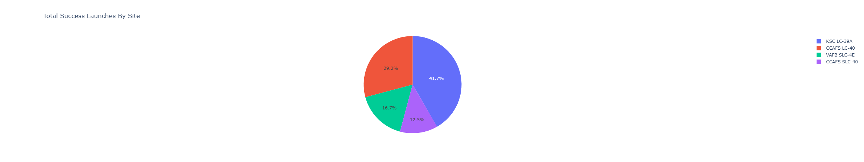
Launch success count for all sites
Explanation
Among all sites, KSC LC-39A has the most successful launches

Slide 42
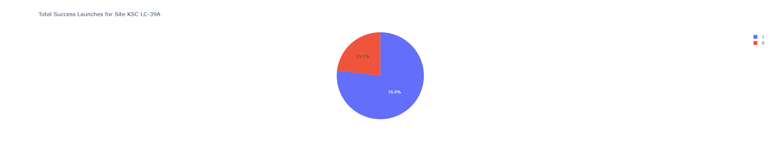
Launch site with highest launch success rate
Explanation
Among all sites, KSC LC-39A also has the highest launch success rate (76.9%)

Slide 43
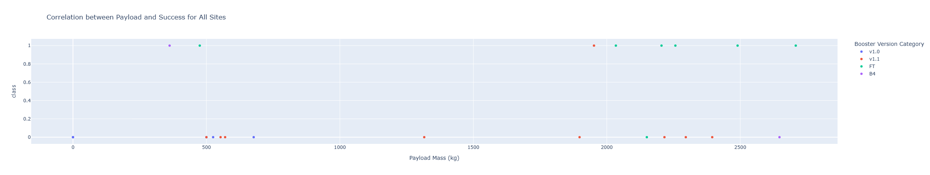
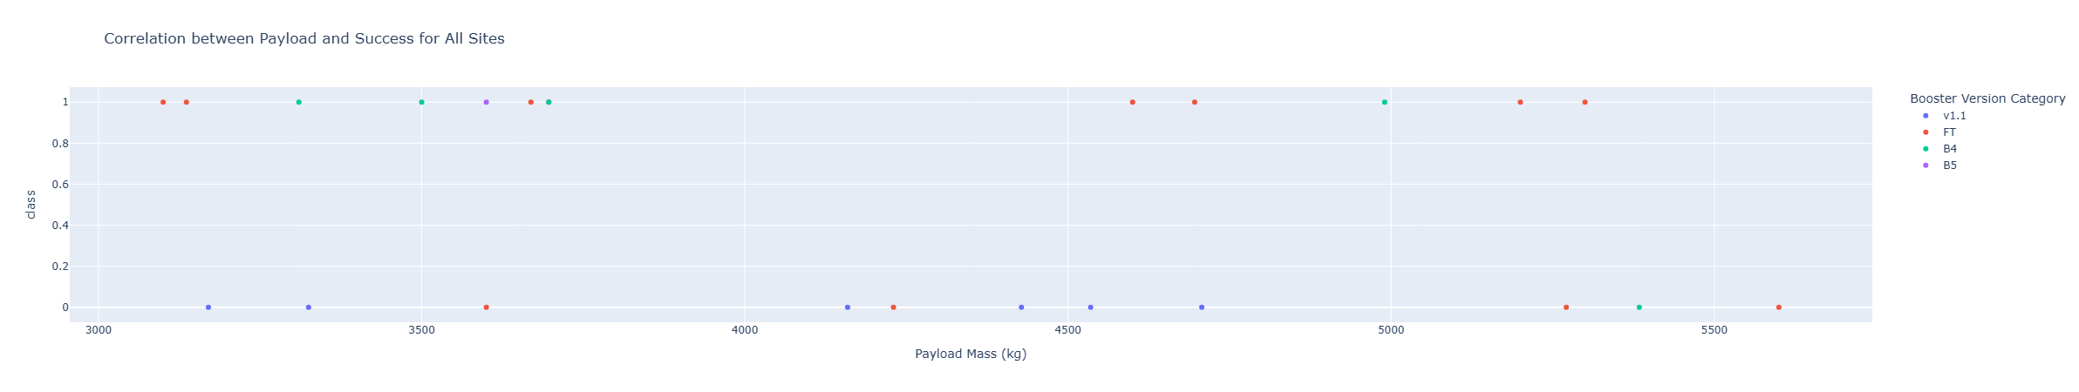
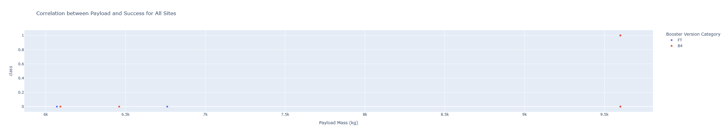
Payload Mass vs. Launch Outcome for all sites
Payload Mass Range: 0~3000 kg
Explanation
The payload mass range with the highest success rate is 3000~5000 kg
Payload Mass Range: 3000~6000 kg
Payload Mass Range: 6000~10000 kg

Slide 44

Section 5

Slide 45
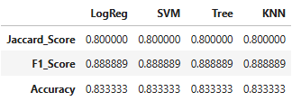
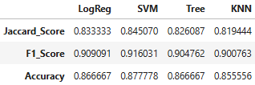
Classification Accuracy
Explanation
All four methods show the same performance on the testing data. The reason could be the small sample size (18).
For performance on the entire data set, the SVM model has slightly higher metrics than the other three models, indicating the SVM method performs the best.
Performance Metrics on Test Data Set
Performance Metrics on Entire Data Set

Slide 46

Confusion Matrix for SVM Model
Explanation
SVM Model has good overall performance
SVM Model has difficulty distinguishing false positive (predicted label = land, true label = did not land) cases

Slide 47
Conclusions
Most launches with payload mass over 8000 kg were successful.
Orbits ES-L1, GEO, HEO, SSO have the highest success rate, 100%, while orbit SO has the lowest success rate, 0%.
For Orbit LEO and ISS, there is positive relationship between payload mass and launch success.
The success rate since 2013 kept increasing till 2020.
All launch sites are in very close proximity to the equator as well as the coast.
Launch Site KSC LC-39A has the most successful launches as well as the highest launch success rate.
SVM model is the best algorithm for the launch success classification.

Slide 48
Appendix
GitHub/TienChiLin/Applied-Data-Science_Capstone
Applied Data Science Capstone Course

Slide 49


